Slide 1
British Airways
Web scrapping and analysis
25/11/2022

Slide 2
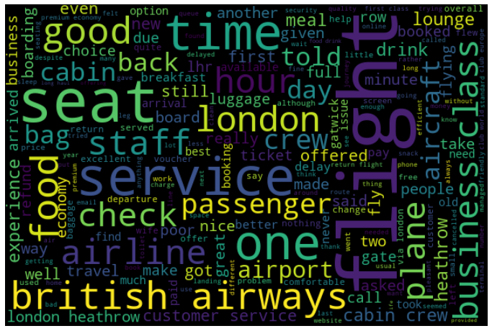
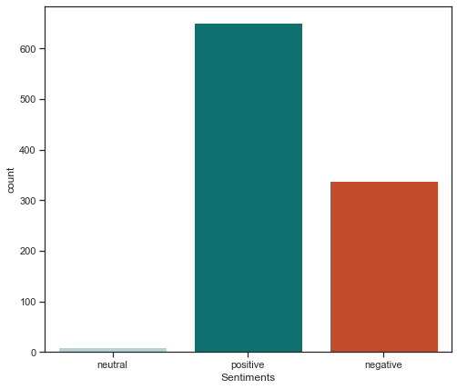
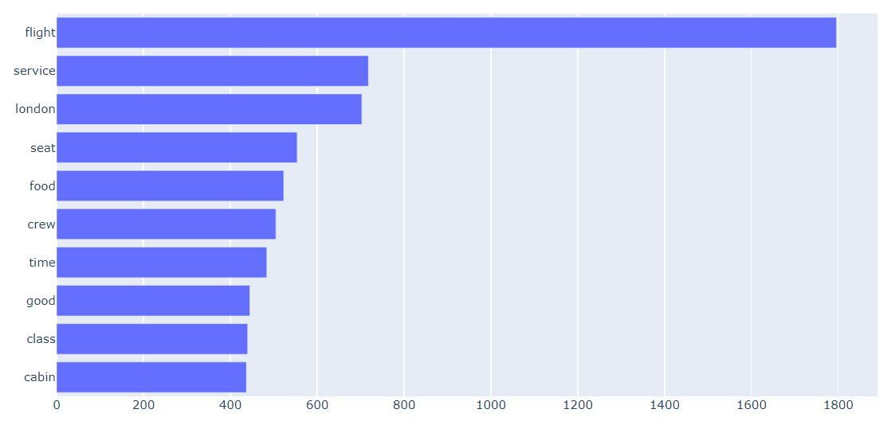
Sentiment analysis
As you can see from Word Cloud and bar chart the most common words in reviews are:
Flight
Service
Seat
Food
Crew
Good
Class
Cabin
So we can say that reviews are about the service provided by British Airways.
Out of all the Sentiments we have:
Positive Sentiments – 651 – 65.1%
Negative Sentiments – 339 – 33.9%
Neutral Sentiments – 10 – 1%

